Slide 1

Airbnb Listings Exploratory Analysis Tue Apr 26, 2022 Michelle Bui

Slide 2

What is Airbnb?
Online, open marketplace for people to rent out their homes to travelers/folks looking for a short term stay
Exponential growth since its inception in 2007
As of 2022:
Over 150 million users
500 million guests hosted per year
Approximately 5.6 million active listings worldwide
60% of its users are millennials
The US is Airbnb’s most profitable market, valued at $33.8 billion in 2018
Notes:
https://www.statista.com/chart/18963/most-popular-us-cities-for-airbnb-homeaway/
https://www.stratosjets.com/blog/airbnb-statistics/
https://www.thezebra.com/resources/home/airbnb-statistics/#infographic
https://medium.com/@alltherooms/10-interesting-airbnb-statistics-6872082ba52e

Slide 3

Image Source: Beautiful AI

Slide 4


Why Airbnb?
Personal curiosity
Data : InsideAirbnb 2021 Active Listings data set
Image Source: Beautiful AI

Slide 5
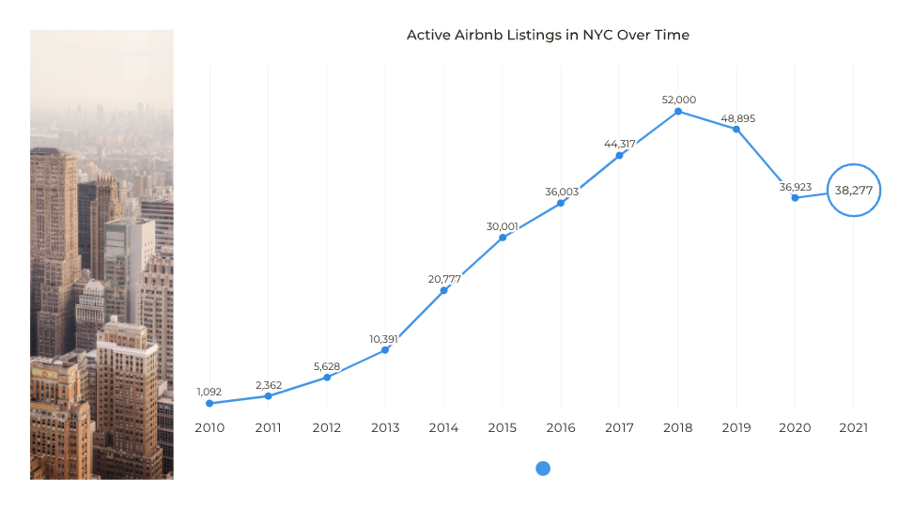

2021: Host Registration Requirement
COVID-19
Data Source: InsideAirbnb
Notes:
https://comptroller.nyc.gov/reports/the-impact-of-airbnb-on-nyc-rents/

Slide 6
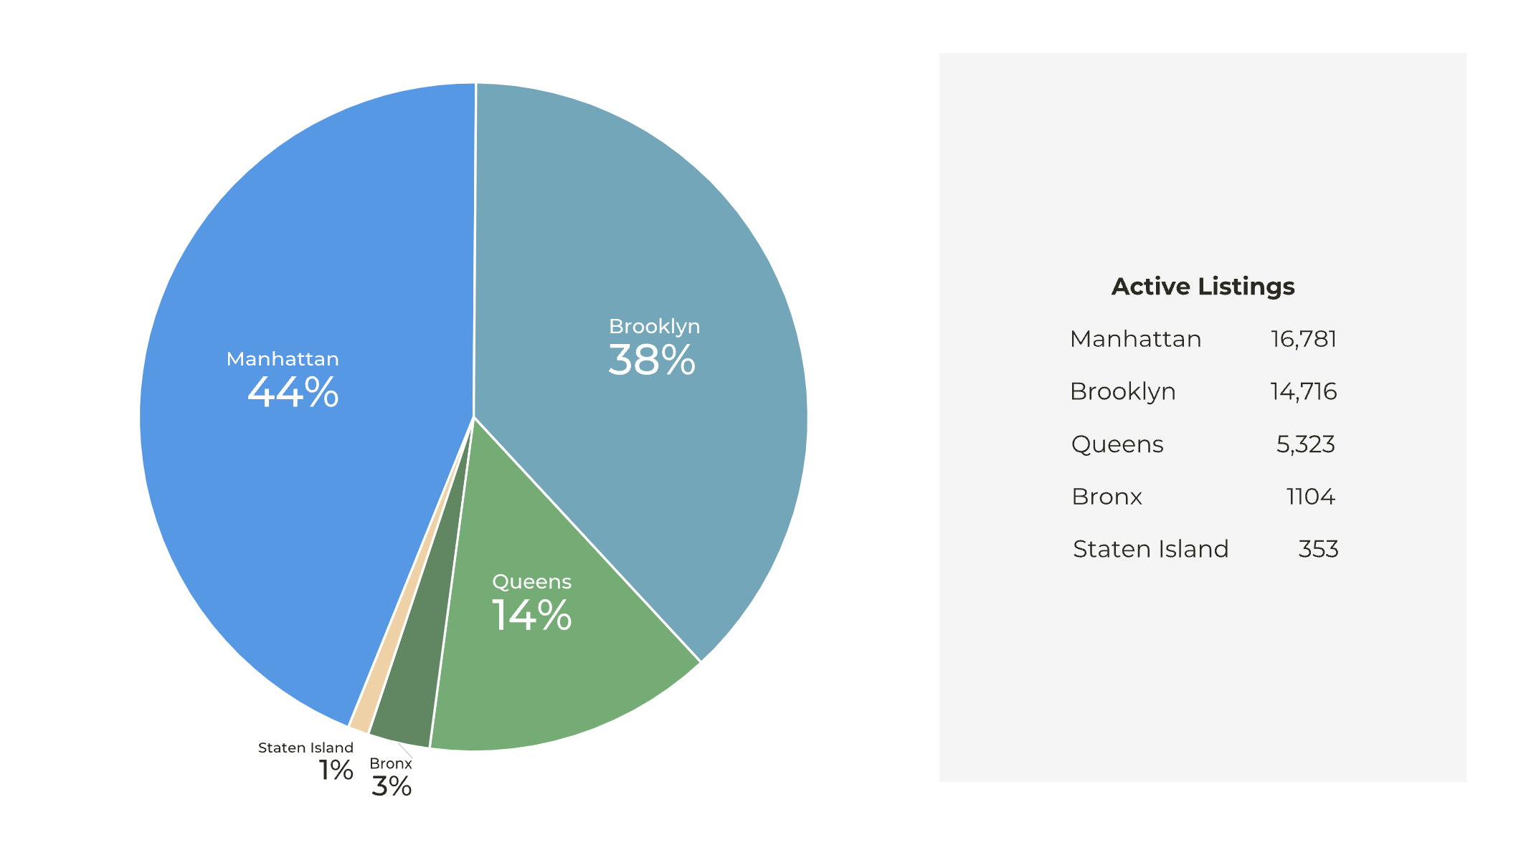
The Most Active Boroughs
96% Of All Listings
Are in
Manhattan,
Brooklyn,
& Queens
Airbnb Listings By Boroughs

Slide 7
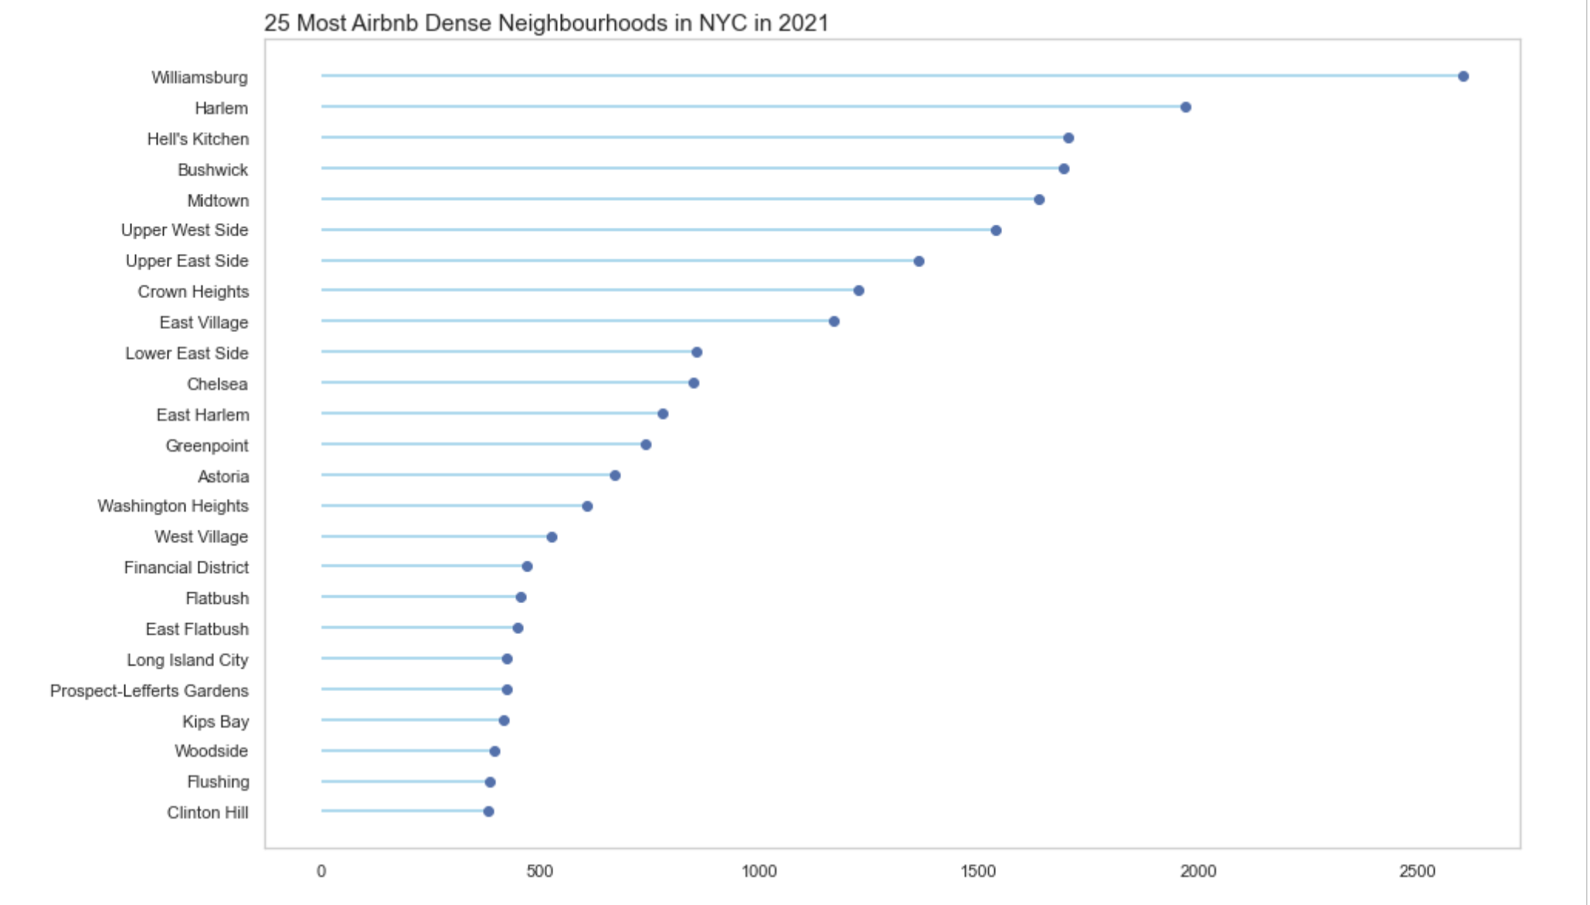
Which neighbourhoods are most popular to host in?

Slide 8
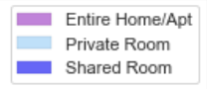
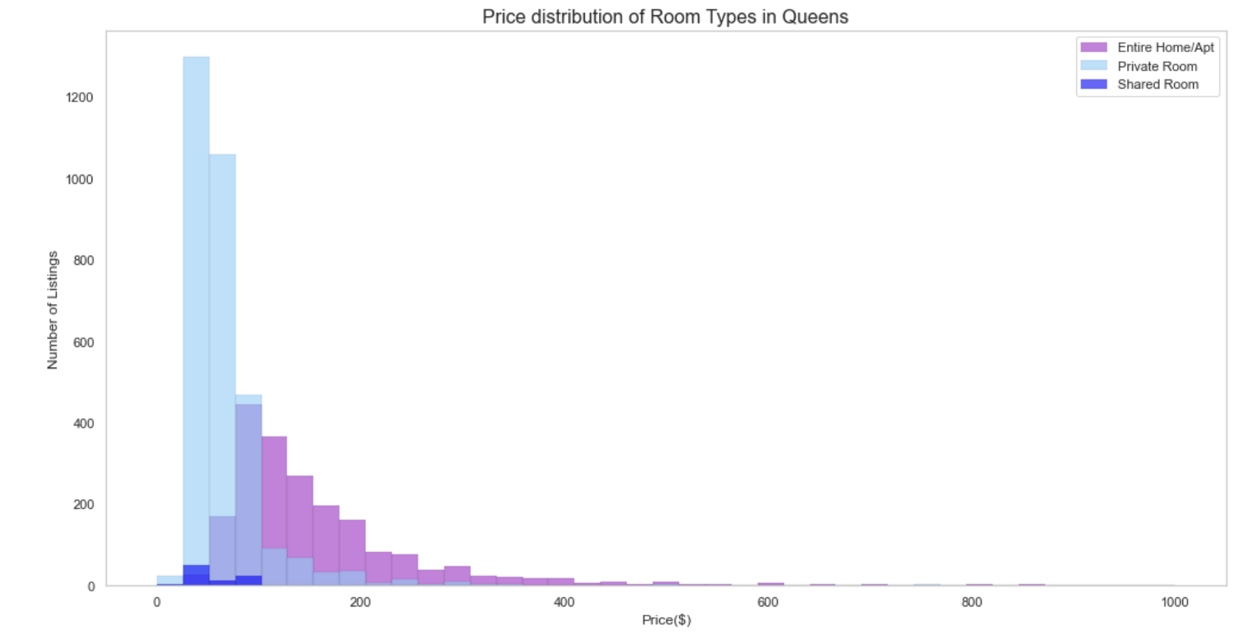
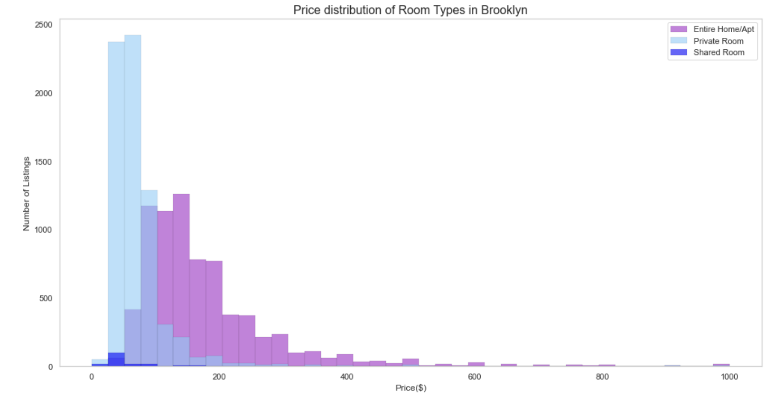
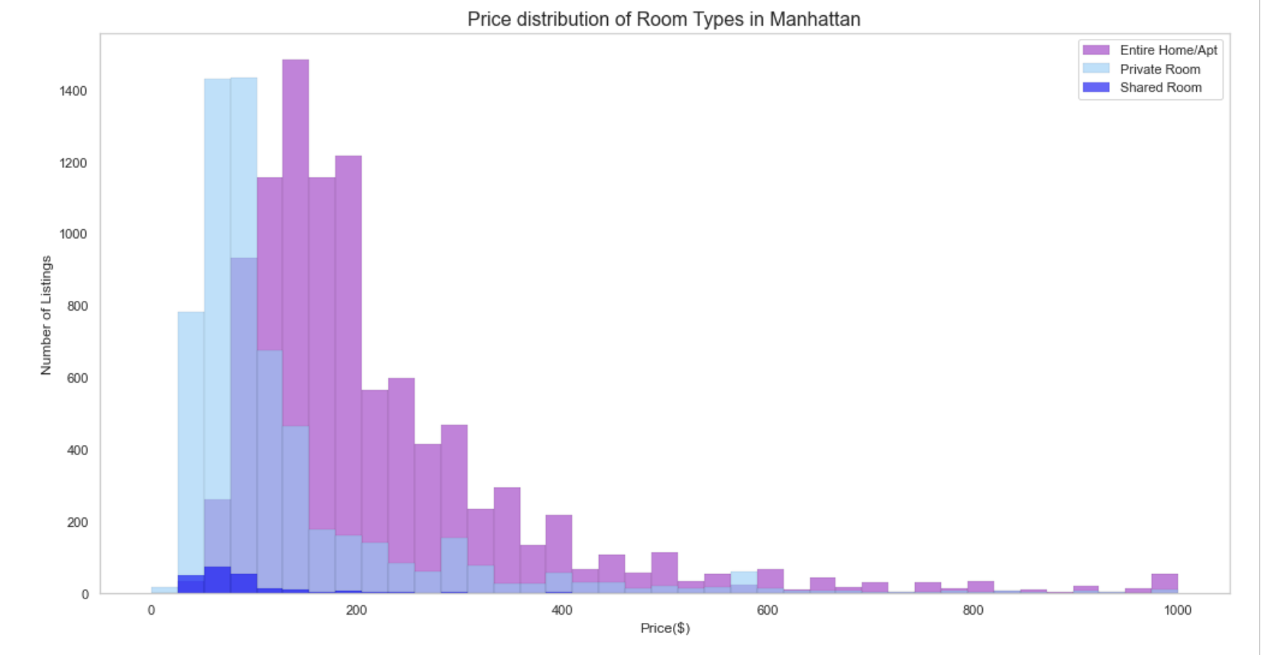
Price Distribution by Room Type
in Manhattan, Brooklyn,
& Queens
Queens
59% Private Room
39% Entire Home
Brooklyn
51% Entire Home
48% Private Room
Manhattan
61% Entire Home
37% Private Room

Slide 9
Majority of listings are entire home/apartment listings in Manhattan and Brooklyn
In Queens, a majority of listings are for private rooms
There is quite a broad price distribution for entire home/apartment listings as well as private room listings
The most dispersion in price can be seen in Manhattan listings

Slide 10
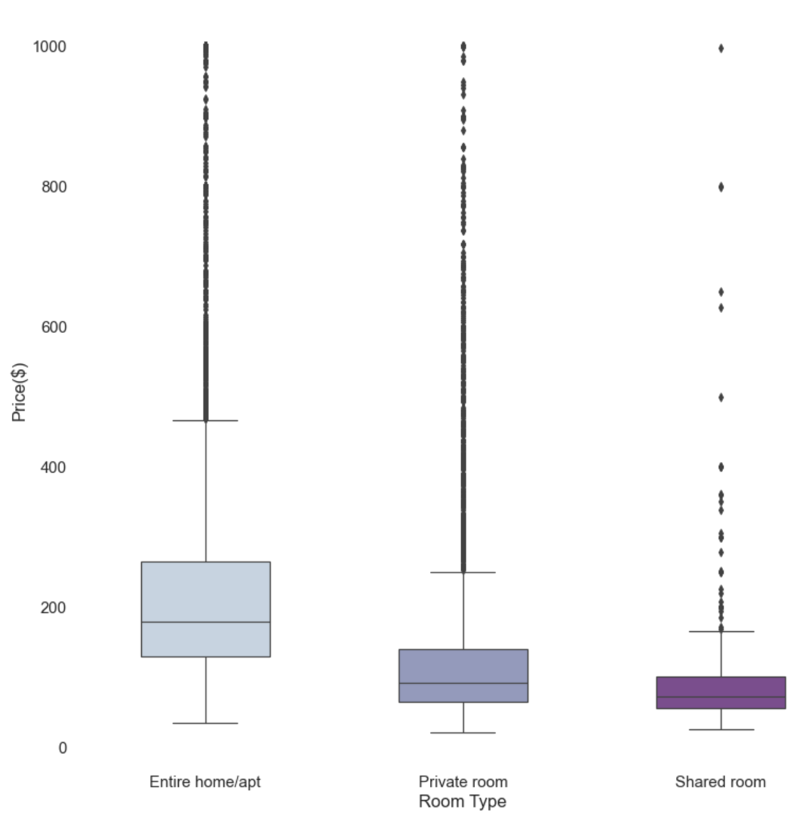
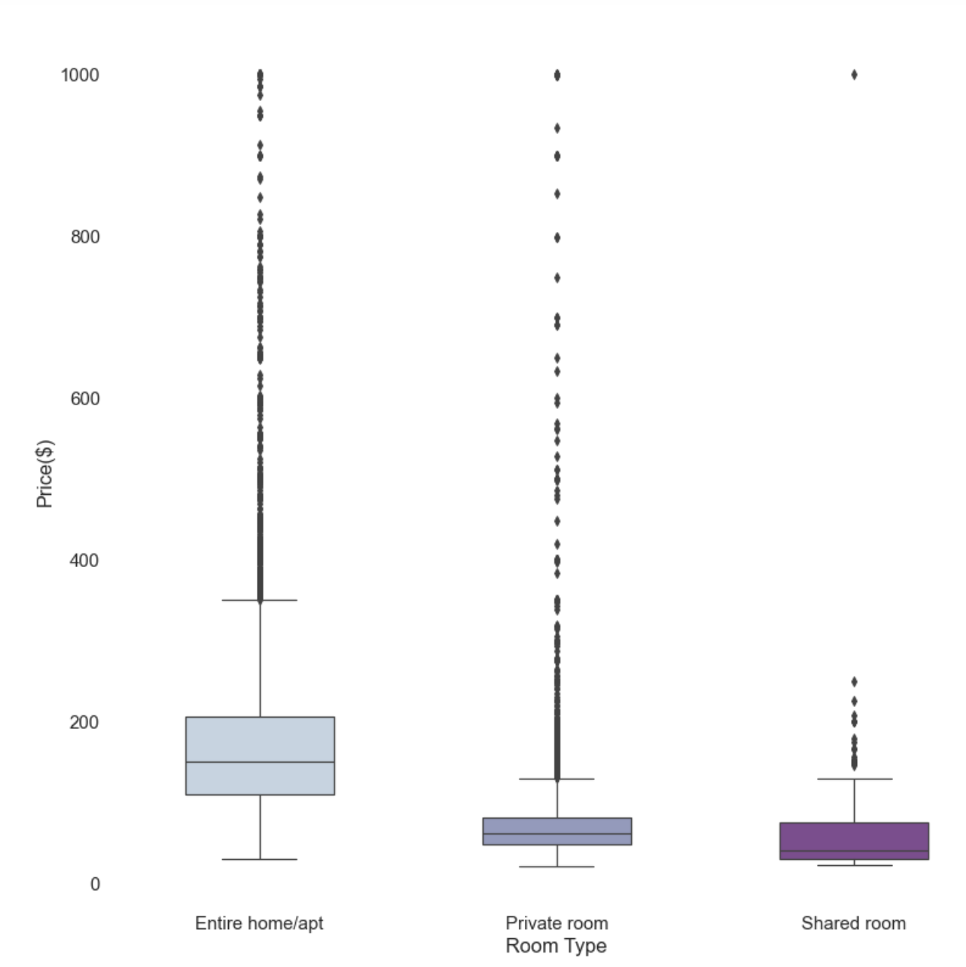
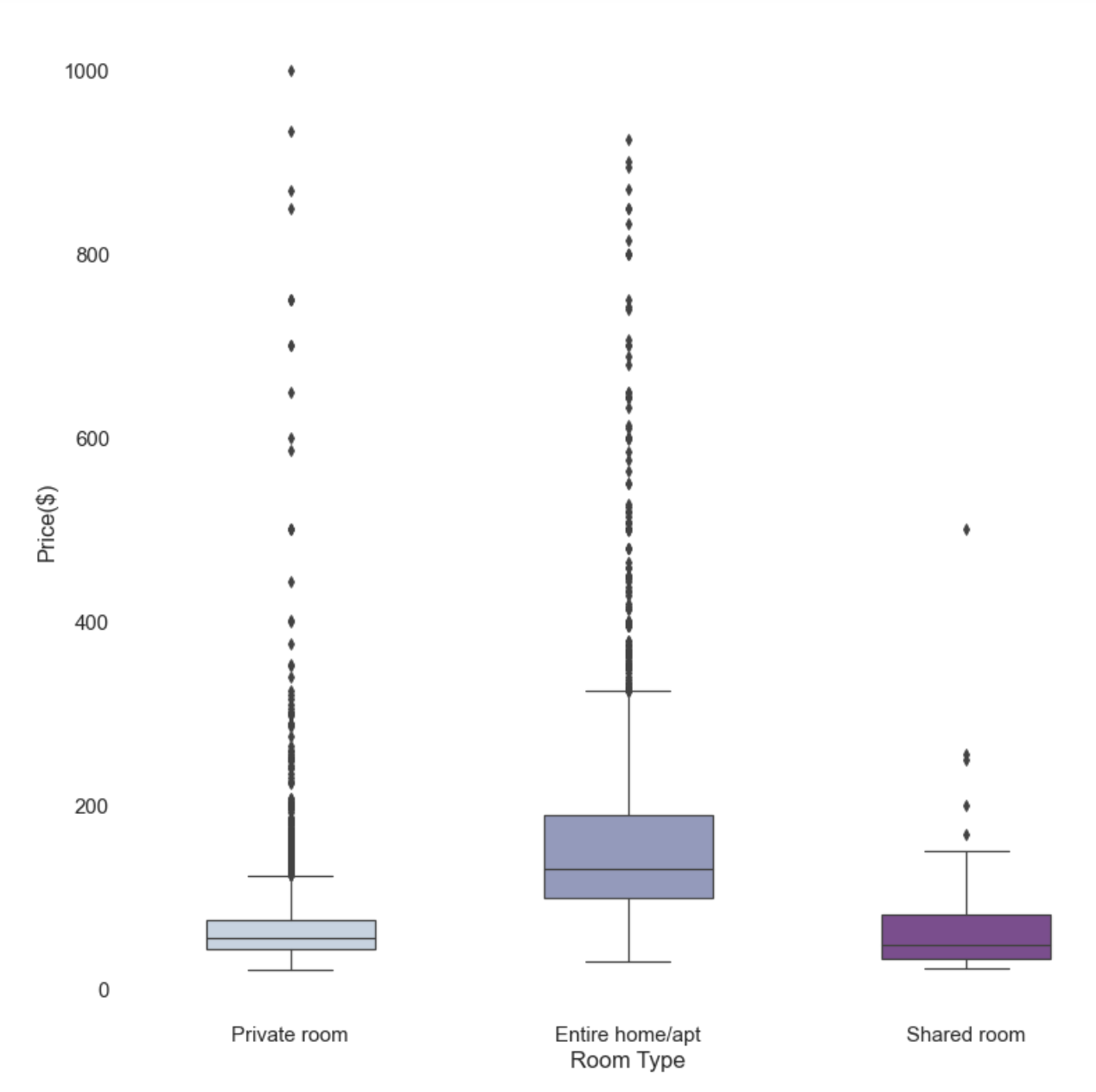
Price vs Room Type
Manhattan
Brooklyn
Queens
Median Price/Night:
$179
$92
$71
$150
$61
$40
$56
$130
$48

Slide 11
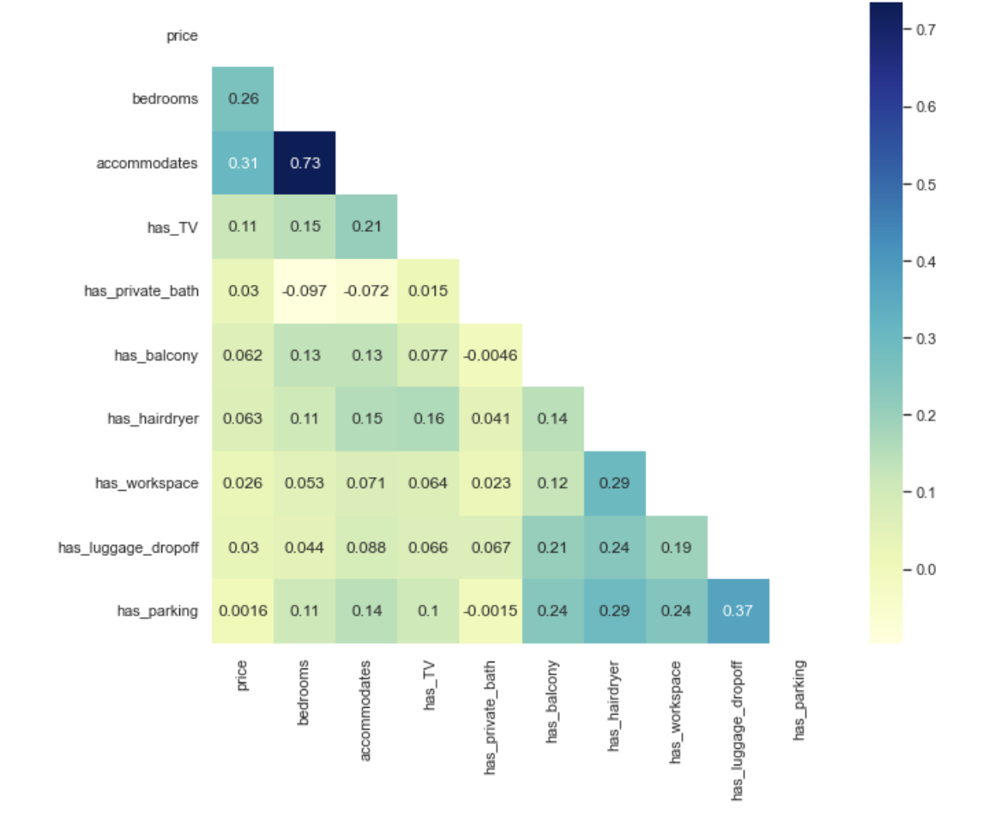

What Drives Price?
Price appears to be most correlated with…
Bedrooms
Number of guests
accommodated

Slide 12
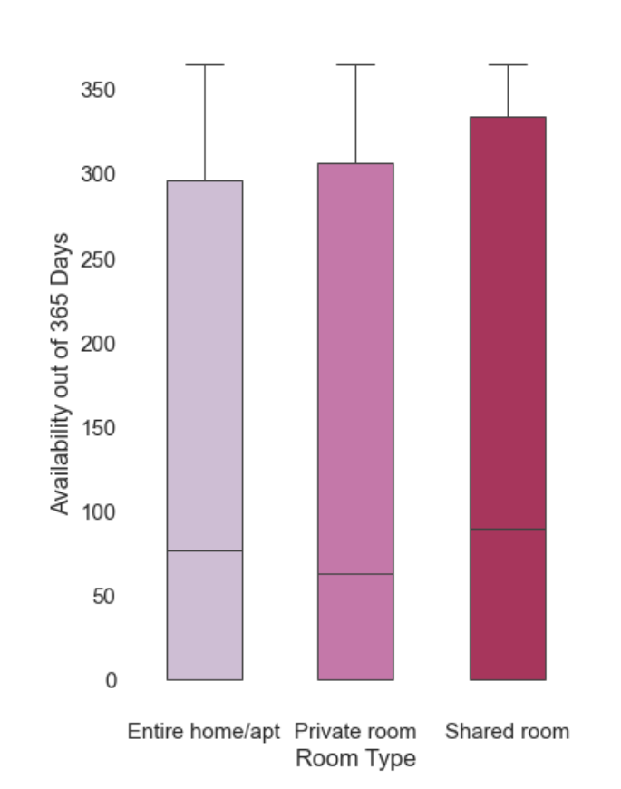
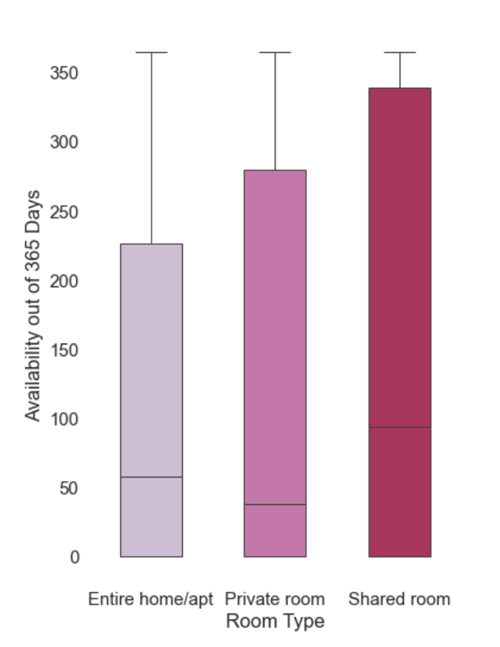
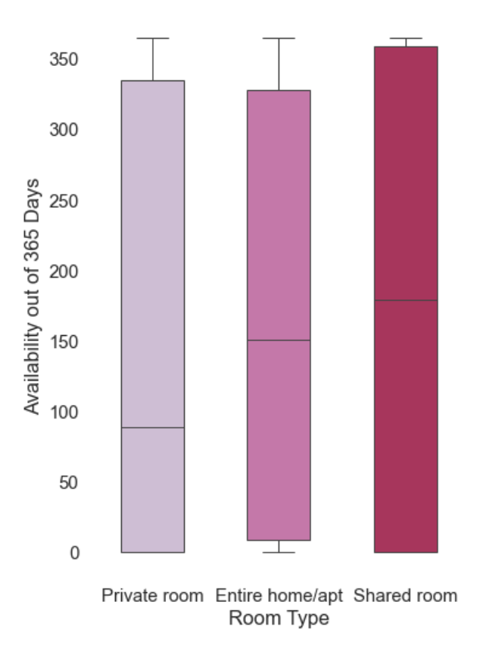
How Available Are These Listings Throughout The Year?
Manhattan
Brooklyn
Queens
Median Availability
In days:
77
63
90
58
38
94
89
151
179

Slide 13
Queens listings overall appear to be made more available by hosts throughout the year
Brooklyn appears to be made less available by hosts throughout the year

Slide 14

Do Hosts Have Multiple Listings?
In Manhattan and Queens, 25% of all room types are available for booking for a large portion of the year (80%+ of the calendar year)
Could it be possible that some hosts
are business users rather than casual users

Slide 15
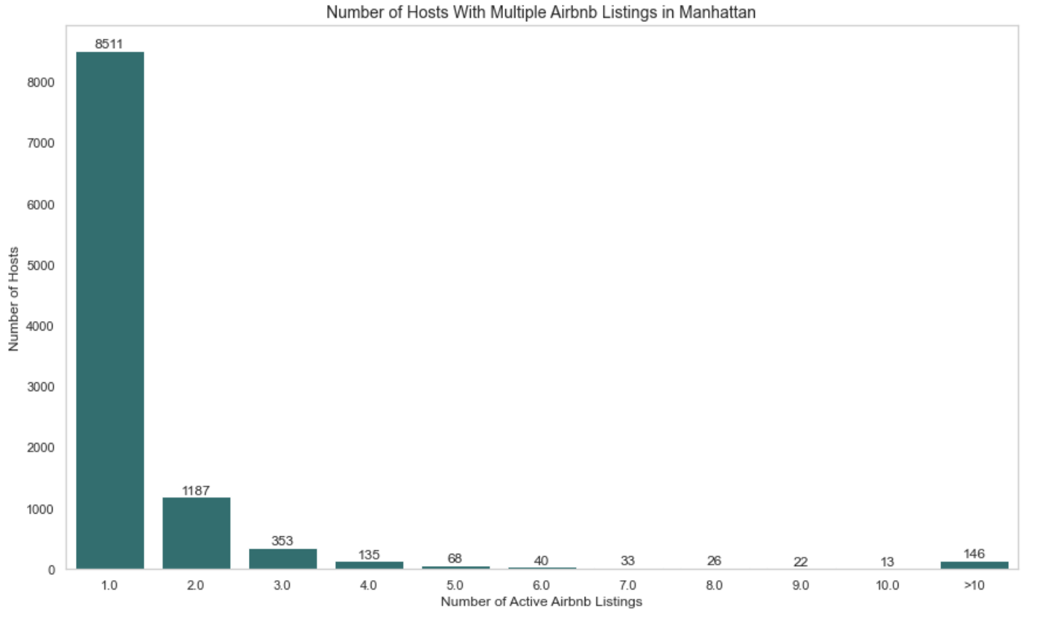
52%
7%
1%
2%

Slide 16
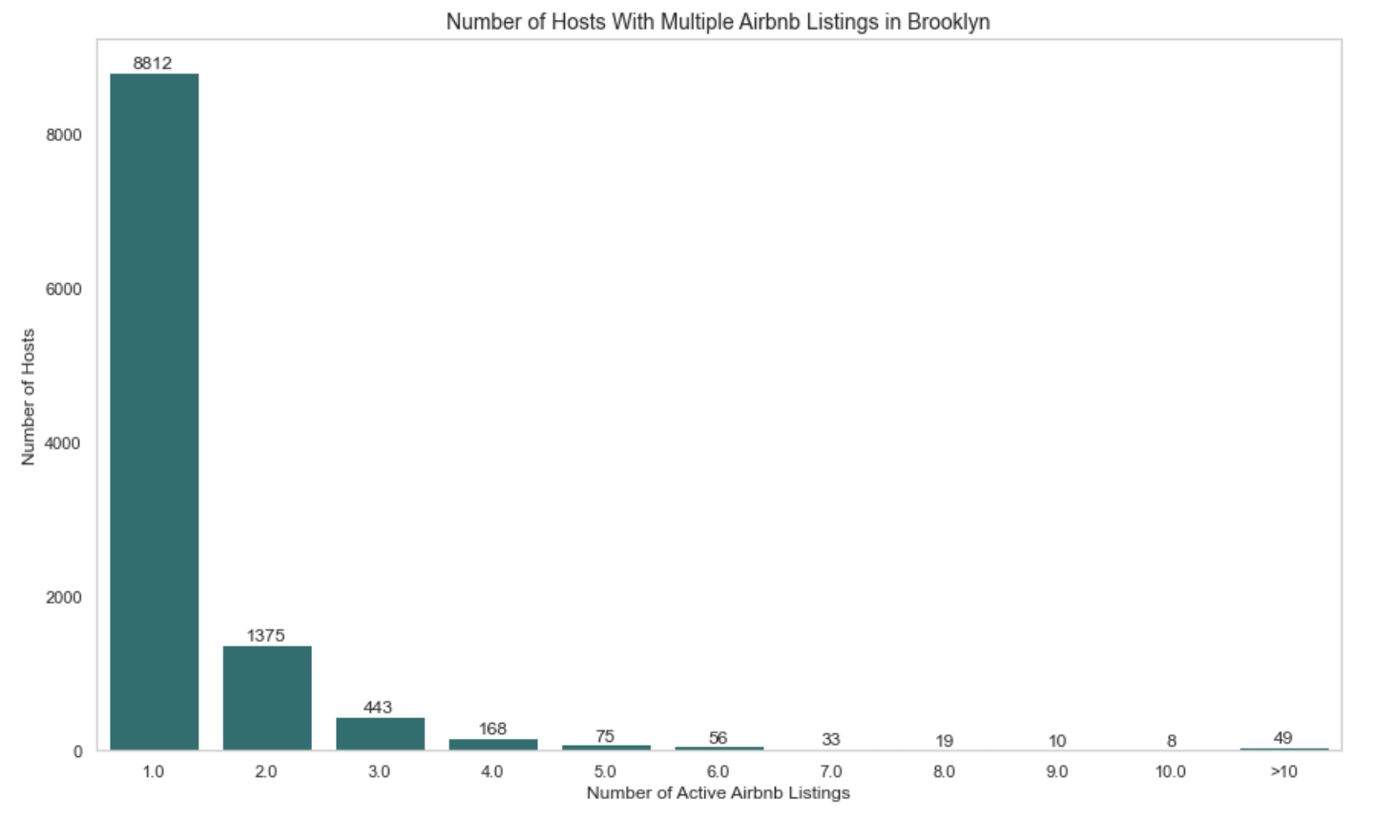
60%
0.3%
9%
3%

Slide 17
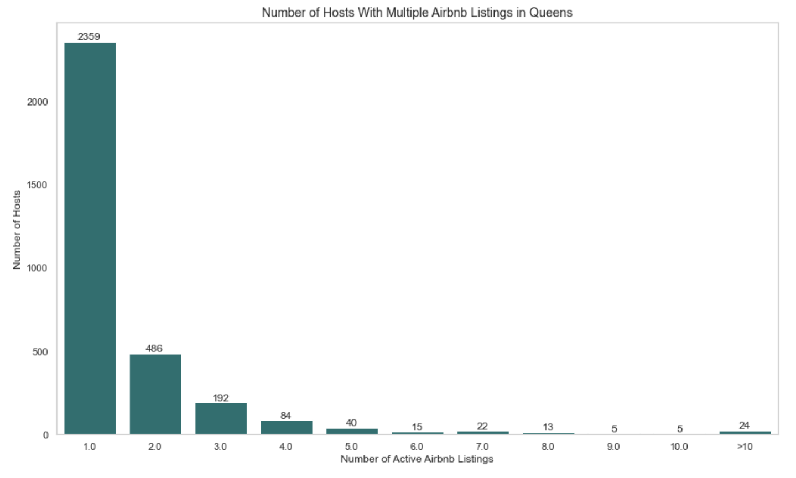
44%
10%
0.4%
4%

Slide 18
To Summarize…
Most Airbnb listings in NYC are entire home/apartment listings
Prices have a broad range across the three different room, but have the largest range in entire home/apartment listings
Price is mostly driven by number of bedrooms and guest accommodations
Majority of hosts in NYC have one Airbnb listing

Slide 19
Areas of Further Analysis
Limited data; occupancy rate and length of stays data were not available in the dataset
Further price analysis using reviews data
Time series analysis of listing growth in each borough over the years, and how the proportion of listing types (room types) may have changed over time
With more complete data, it would be interesting to compare Airbnb listing growth data over time with rental price changes over time to see if the Airbnb growth spurts have affected the long term rental market

Slide 20
Sources
https://www.statista.com/chart/18963/most-popular-us-cities-for-airbnb-homeaway/
https://www.stratosjets.com/blog/airbnb-statistics/
https://www.thezebra.com/resources/home/airbnb-statistics/#infographic
https://medium.com/@alltherooms/10-interesting-airbnb-statistics-6872082ba52e
2021 NYC Airbnb Listings Data: http://insideairbnb.com/

